Slide 1
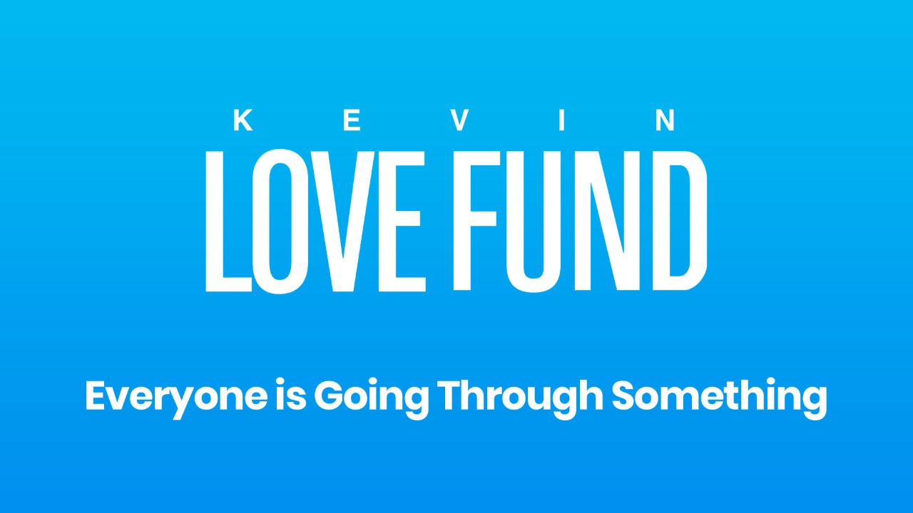

Slide 2

Today
Another way to think about emotion
Expert Video
Guest Artist Video
Creative Activity: Found Poem
Two Ways We’ve Explored Emotion So Far:
1. Something to be honored and expressed.
2. Information that something needs to be changed in the world or in our lives.
Today, a new way:
as the feelings that are often connected to our thoughts.

Slide 3

Write a Found Poem
Choose an inaccurate thought to inspire your poem.
First stanza represents: “Something I used to believe was true is....”
Second stanza represents: “But now I know...”
Block out words with a black marker. The remaining words form your poem.

Slide 4

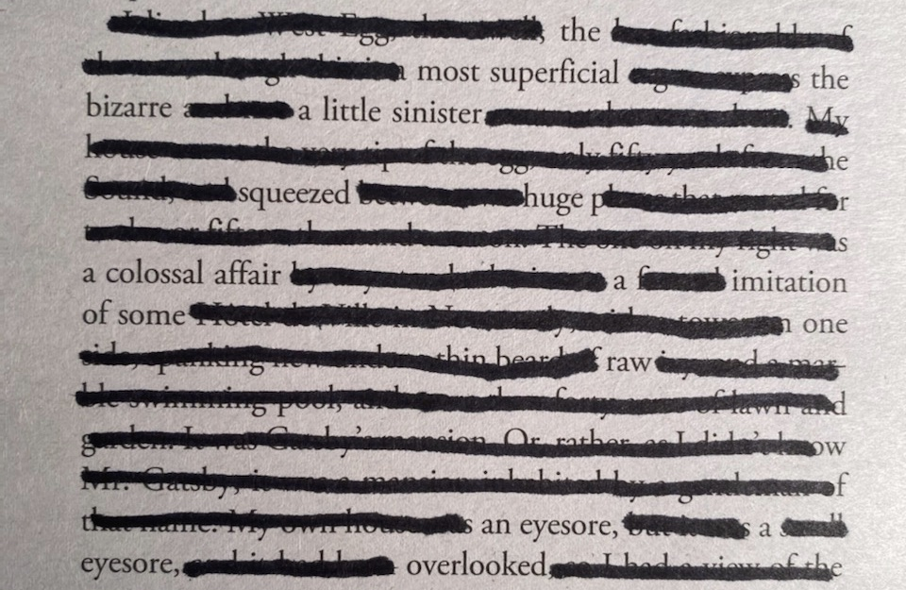
Example of a Found Poem Stanza One:
The inaccurate thought that inspires this poem:
I’m not beautiful, and I feel insecure about my body.
Stanza One: I used to believe…

Slide 5
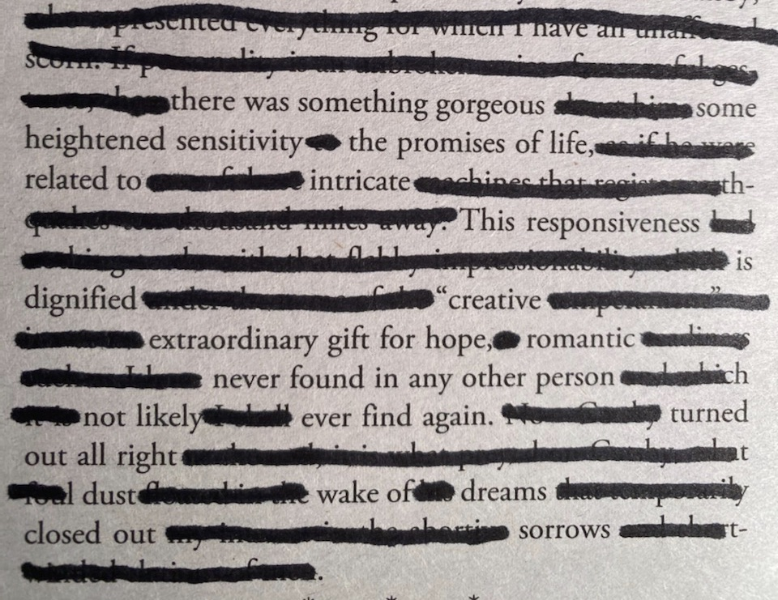
Example of a Found Poem
Stanza Two:
Stanza Two: But now I know…

