Slide 1


Slide 2
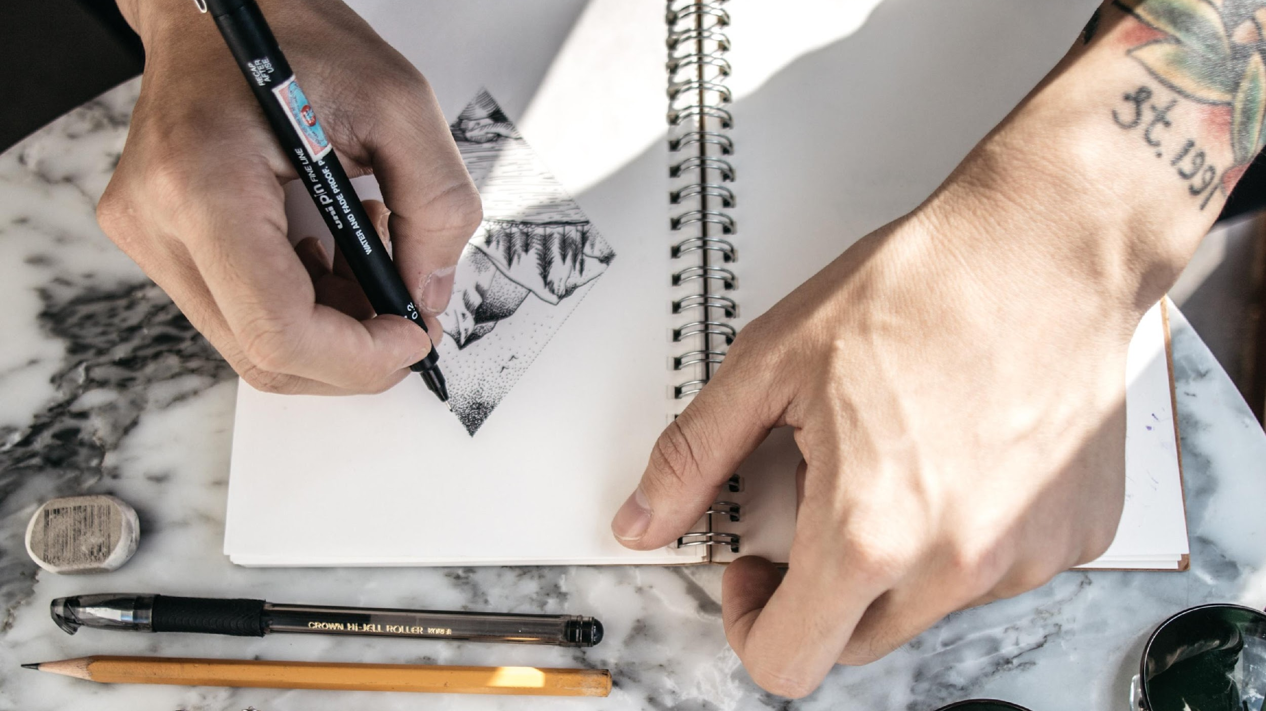
Today:
Review Big Ideas
Expert Video
Creative Activity: Choose Your Artistic Medium

Slide 3
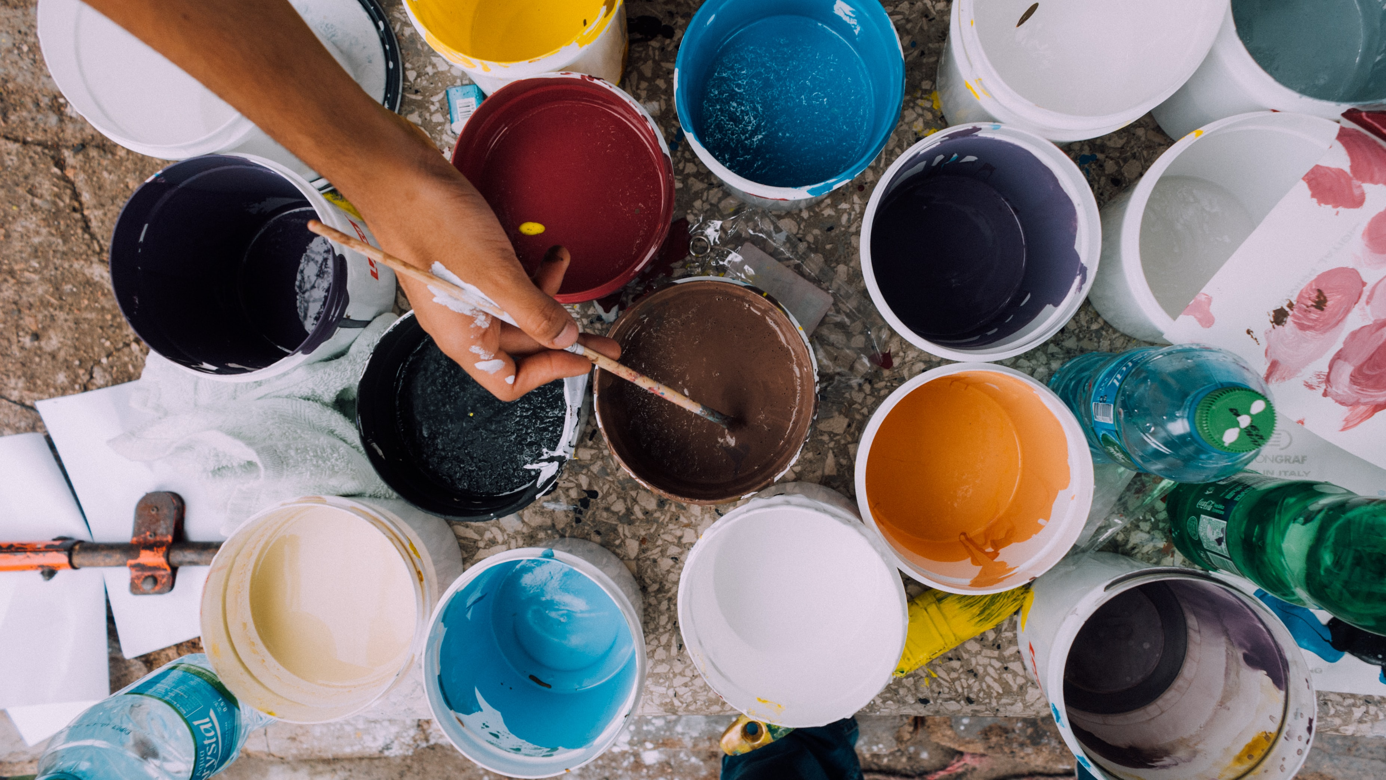
Reflection Project
How do you want to organize and illustrate the supportive techniques you’ve learned?
What do you want to take from these discussions and activities?
Choose an artistic medium (photography, drawing, painting, letter writing, poetry, collage) to help you remember your favorite ideas from these lessons.

