Slide 1


Slide 2

Today:
Guest Artist Video: Kevin Love
Creative Activity: Write the Message of Your Life

Slide 3
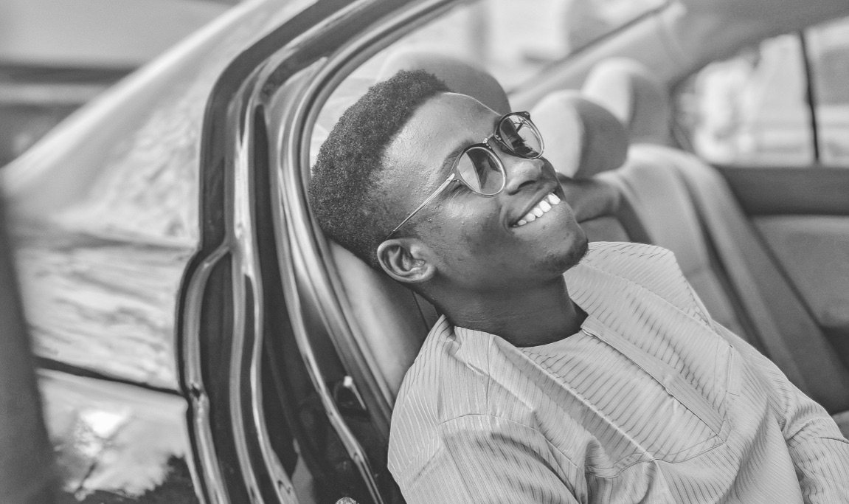
“________________”
A story to Inspire You: Gandhi and the Reporter’s Question

Slide 4
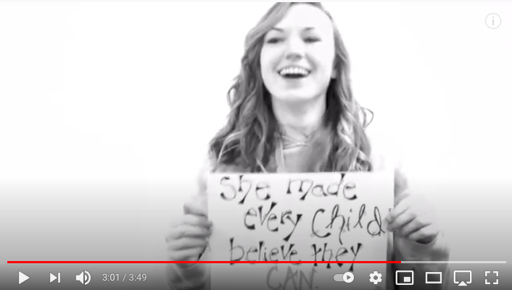
Creative Activity: What’s the Message of Your Life?
Imagine yourself 30 years in the future. From this perspective answer the question: What have you contributed to the world? What has become most important to you? What do you stand for? Write your answer in a single sentence on the sheet of paper I provided for you.

