Slide 1



Slide 2
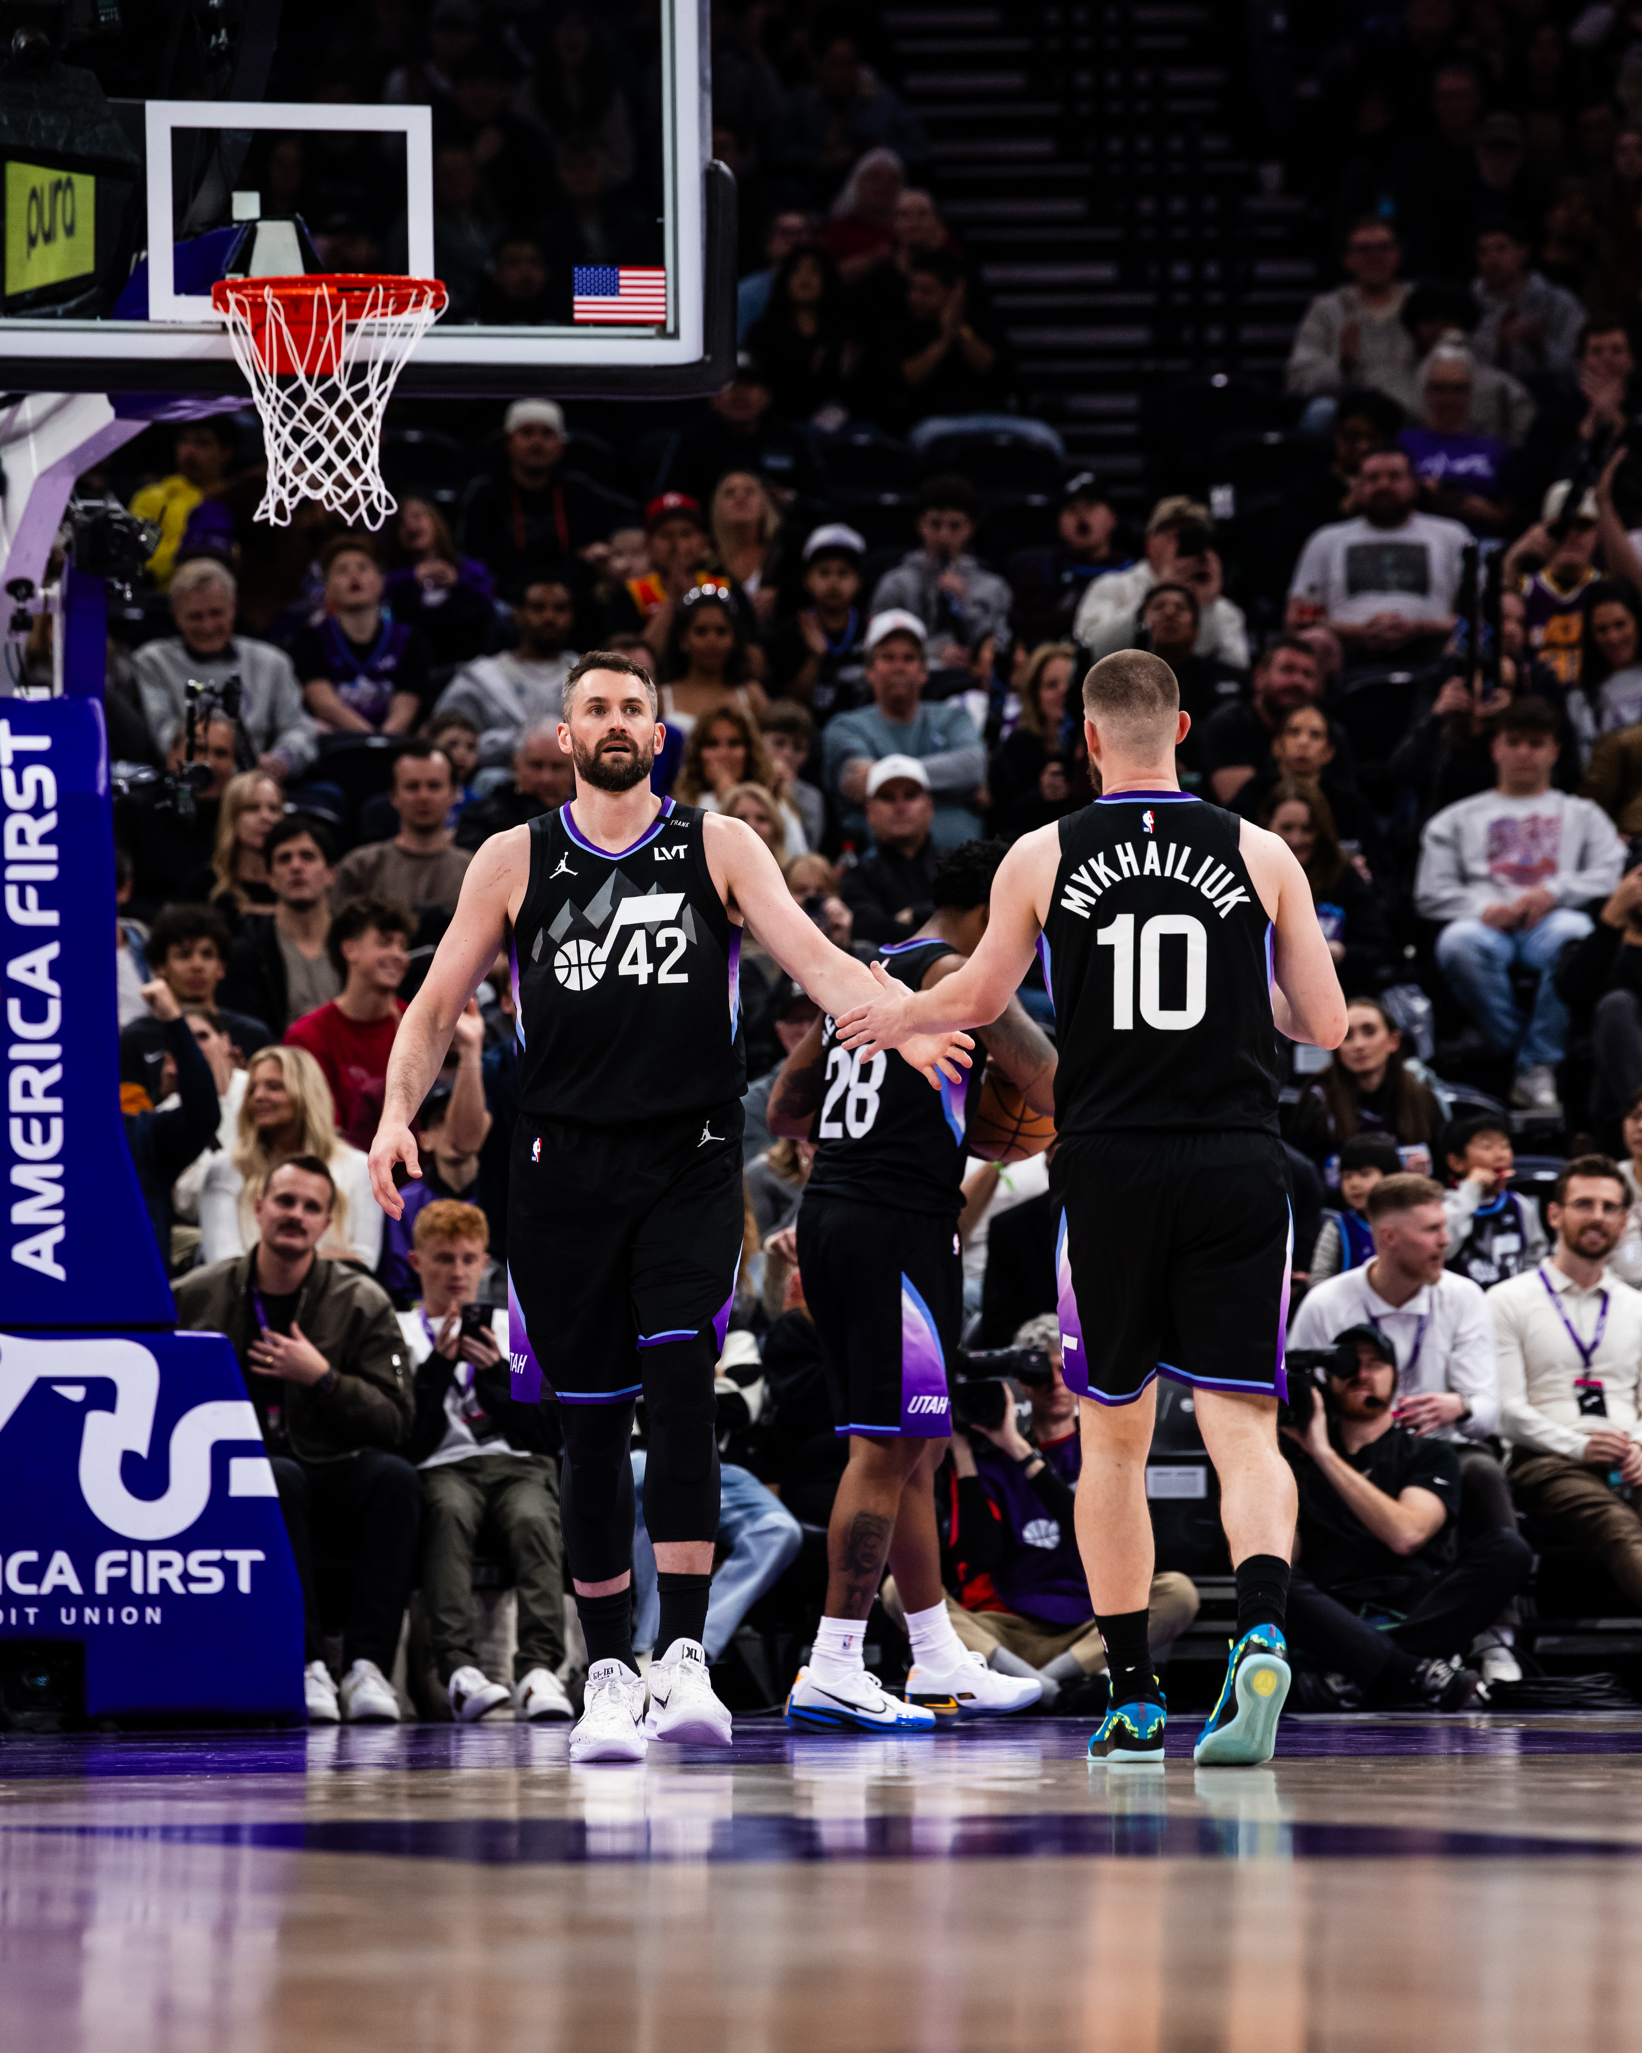
Real Talk: Strength in Seeking Support
“If you’re having a hard time, I want to remind you that you’re not alone. Sharing what you’re going through could be the most important thing you do. It was for me.”
- Kevin Love

Slide 3

Behind the Game Face
Warm-Up Activity
Front of Index Card:
What’s your ‘game face’?
How others see you (teammates, coaches, family, friends, etc.)
Back of Index Card:
What others don’t see
Emotions or struggles you don't always share (worries, stress, injury, challenges, etc.)

Slide 4
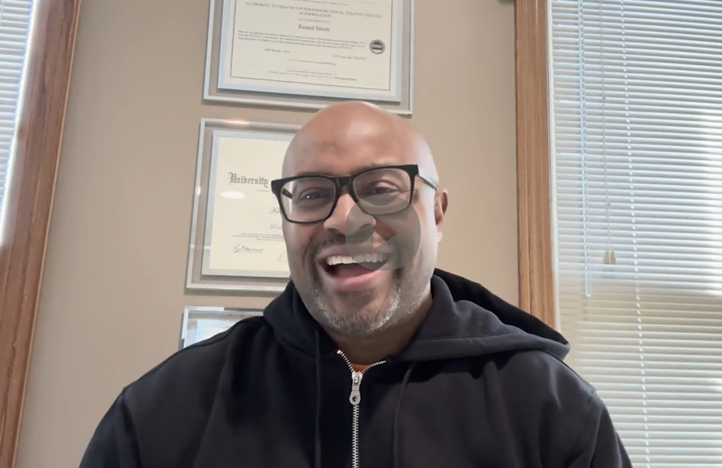
Let’s hear from an expert…
Dr. R Kweku Amoasi
Team USA Psychologist

Slide 5
Make a Music Playlist
Choose a few songs that helped you get through a challenging time.
Write down why you picked that song for your playlist.
Draw/design a picture as the cover art for your playlist, if you have extra time.

Slide 6

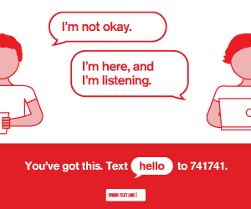
Resources
Emergency Services: Call 911
Suicide & Crisis Lifeline: Call, Text, or Chat 988
Crisis Text Line: Text "HOME" to 741741
Kevin Love Fund Resources
Visit: kevinlovefund.org/resources
NAMI Teen & Young Adult HelpLine
Call: 800-950-NAMI (6264)
Text: "FRIEND" to 62640
Email: helpline@nami.org
Web: nami.org/youth
Ask your coach or teacher for campus and local resources.

