Slide 1

Everyone is Going Through Something

Slide 2
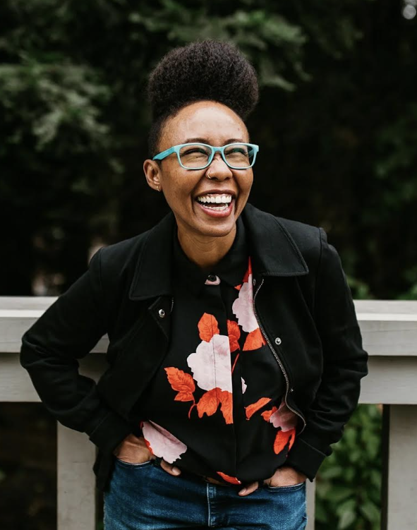
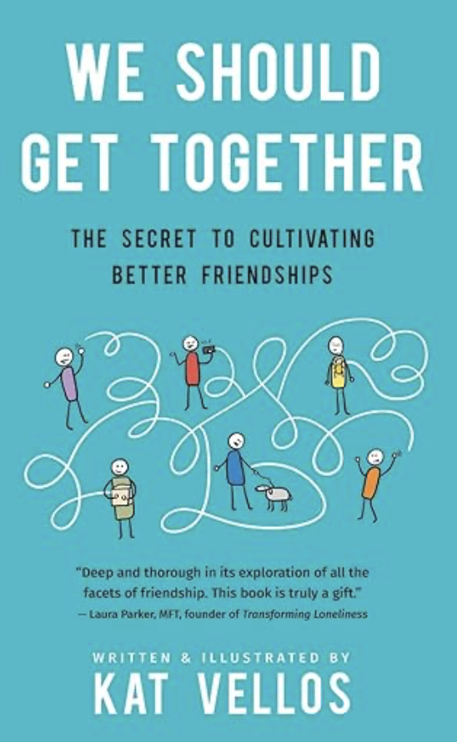
The Friend Effect: Creating Community and Building Positive Relationships
“I’ve had great relationships and friendships over the years that pay dividends and give back so much in my life. These friendships affect my mental health, impact my everyday life, and really make me happier on a daily basis.”
- Kevin Love

Slide 3
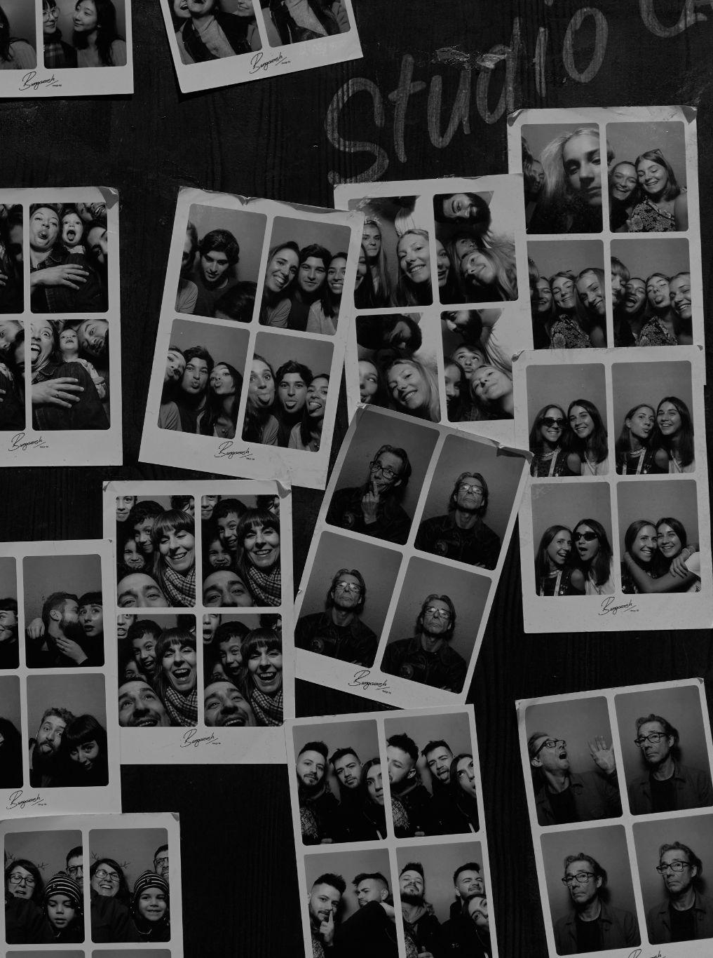
Creative Activity
Create a collage of photos featuring friends or family that capture happy moments and shared experiences, highlighting what you value most about those relationships.

